Slide 1
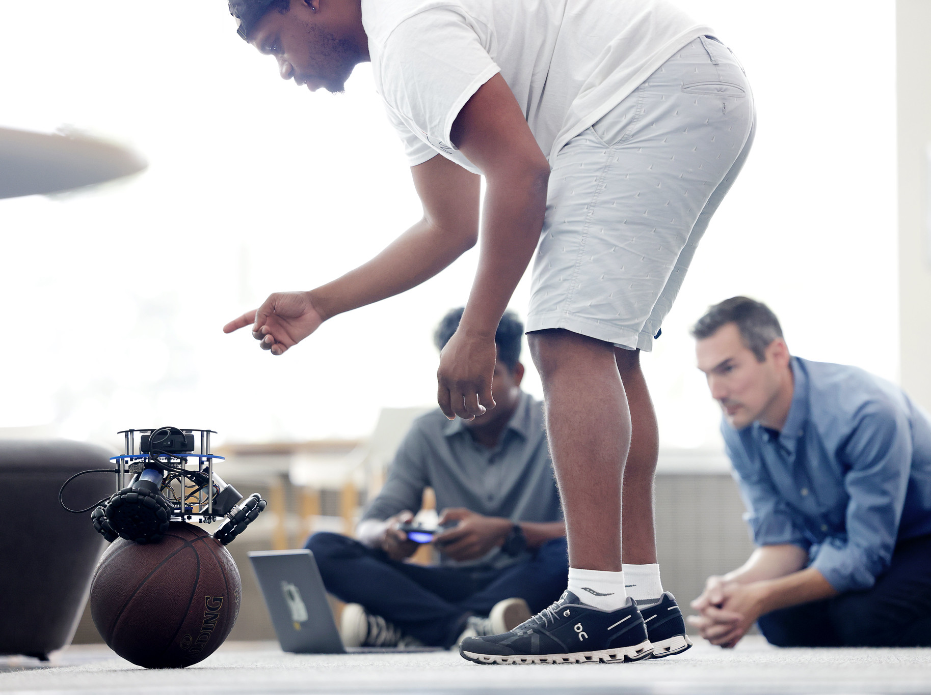
Robotics 311 : How to build robots and make them move
Prof. Elliott Rouse
GSI Yves Nazon MS
Fall 2022
Photo credit: Brenda Ahearn / U-M CoE

Slide 2
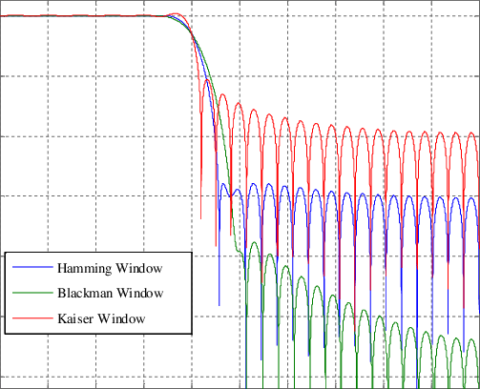

ROB 311 – Lab 13
Today, we will learn about real time filtering in python!
ROB 311

Slide 3
ROB 311 – FIR Filters
What is an FIR Filter
FIR filter is an Finite Impulse Response filter
The response of the filter goes to zero in a finite amount of time
The other type of filter is an IIR filter
Pros and cons
Pros: inherently stable, induce delay but dont distort signal phase (linear phase)
Cons: it takes time to execute, uses more memory than IIR filter
ROB 311

Slide 4
ROB 311 – Moving Average Filter
What is a moving average filter
A smoothing filter
Performs like a low pass filter
Pros and Cons
Pros: smooths data, rejects outliers well, easy to implement
Cons: computationally expensive, can add notable lag\phase shift to signal
Weighted Moving Average Filter
Allows user to value or weight discrete time points more/less
Note: if the weights of the filter are not symmetric you will introduce a phase shift
ROB 311

Slide 5
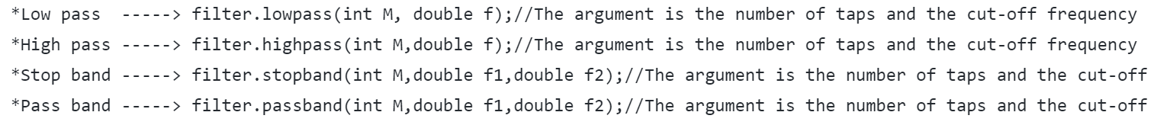
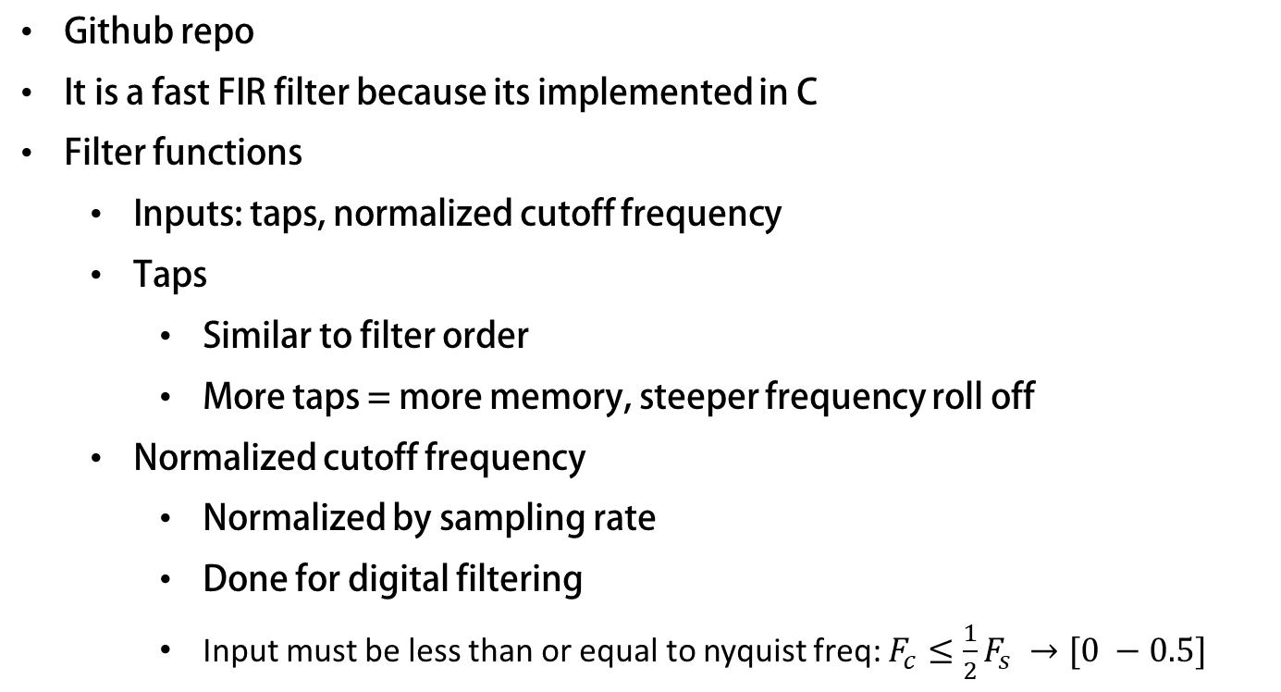
ROB 311 – Real Time FIR Filter
Github repo
It is a fast FIR filter because its implemented in C
Filter functions
Inputs: taps, normalized cutoff frequency
Taps
Similar to filter order
More taps = more memory, steeper frequency roll off
Normalized cutoff frequency
Normalized by sampling rate
Done for digital filtering
Input must be less than or equal to nyquist freq: $F_{c}≤\frac{1}{2}F_{s} →[0 −0.5]$
ROB 311

Slide 6
ROB 311– Todays Lab
Implement weighted moving average and low pass fir filters in python
Clone Lab Repo Here: https://github.com/neurobionics/rob311_filtering_lab
Add FIR.py, ROB311_filtering_demo.py, and _FIR.so to your pi
Plot and analyze filtered signals in MATLAB
Use ROB311_Filtering_Demo.txt and plotter.m as example
Use moving average filter to filter IMU values on ballbot
ROB 311

